Slide 1
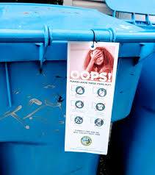
What is TRUE STORYTELLING of NMSU recycling?
“Things tell a Story” (William James, 1907: 96)
David M. Boje
davidboje@gmail.com

Slide 2
Boje’s 6 Step Lesson Plan Sep 10th
Step One:
A. HHT by telling a partner why putting recyclables into the classroom's trash bin is ecologically irresponsible
B. 2 Homework questions:
Homework Question 3a: 'Living Story' of you using 3 principles of TRUE STORYTELLING in the NMSU 'World of Life' routines to RECYCLE (or Contaminate), and 3b: How to use True Storytelling to bring about your PopUp Event of your chosen UN Sustainable Development Goal.
C. Boal - the Columbian Leader Hypnosis of followers
Step Two:
A. Grading Last week's homework
B.Boje Lesson Plan Slides for today with YouTube and
TAKE Boje's RECYCLING INTELLIGENCE QUIZ (will distribute copy in class)
Here is the Quiz scoring sheet
‪FYI: Boal THEATER OF THE OPPRESSED INTRO Presentation - 2015
YouTube for lesson: Why China doesn't want your waste anymore - BBC News
What are the 7 True Storytelling Principles?http://truestorytelling.org
Truth: You yourself must be true and prepare the energy and effort for a sustainable future
Make room: True storytelling makes spaces respecting the stories already there
Plot: You must create stories with a clear plot creating direction and help people prioritize
Timing: You must have timing
Help stories along: You must be able to help stories on their way and be open to experiment
Staging: You must consider staging including scenography and artifacts
Reflection: You must reflect on the stories and how they create value
Step Three: Interactive Activity
We will do Principle 1, 2, & 3 of True Storytelling: what is the truth of recycling in all six colleges. We will divide into six groups, take separate field trips to the colleges, and inventory the exact location of the Big Blue Bins on wheels and the plastic bottle/aluminum can recycle bins (what building, what floor, exact location), and in any open classroom, what recycling bins (perhaps those small one foot blue bins are there or not) on what floor, in what room number, in what building. Return to class and answer the question: Principle 1: Does NMSU have energy and effort for a sustainable future (in its recycling)? Principle 2: Makes spaces for respecting the [recycling] stories [at NMSU] already there {in each college]. Principle 3: Plot: You must create stories with a clear plot creating direction and help people prioritize[as leaders, create a clear plot creating direction and help people [at NMSU prioritize ways of solving the global recycling crisis].
Step Four: + and - for today
Step Five: fill out evaluation of today's event
Step Six: presenting team does not do homework today (due next week) since they help grade what comes in

Slide 3
First Take the Recycling Intelligence Test
Click for Recycling Intelligence Quiz (Word document).
Take the quiz, and add up number of correct answers, when you get the answer key.

Slide 4
Extra Credit: read your 388 text# 17.
Foucault, Michel (1979). Discipline and Punish.... Available online downloadable and searchable PDF
You will learn why Power➔Knowledge
The STATE of NEW MEXICO is a Political Economy and a Business Economy whose leaders decide what is RECYCLING KNOWLEDGE, decide the Recyclable Materials legally recyclable by cities, counties, and STATE universities.
Therefore, Power➔Knowledge exists in the reality of recycling, in the “micro-powers” (p. 27), and in the changes in “power relations” in NMSU and STATE of NM history

Slide 5
Witness NM Recycling History
In early 1980’s, New Mexicans relied on community “dumps” which were often nothing more than open trenches. These “dumps” were regularly set on fire to “reduce” their volume and to make way for more trash. These sites are scattered across the state and can be found in close proximity to every pueblo, village and rural community. Managing solid waste in this way meant groundwater, surface water, or air could easily become polluted. SOURCE

Slide 6
Then a change in Leadership
New Mexico adopted the federal standards by passing the New Mexico Solid Waste Act of 1990. Today’s landfills are vastly different from the burn pits of the past
THEN ANOTHER CHANGE IN LEADERSHIP in LAST DECADE, and in 2018 CHINA CHANGED ITS STANDARDS OF RECYCLING in ways that matters to NEW Mexicans

Slide 7
China ➔ New Mexico
Recycling markets were upended in 2017 when China, as part of an anti-pollution crackdown, announced it would stop importing most used plastic and paper. One reason: Too many imported recyclables were contaminated, sometimes withhazardous substances like lead and mercury. The decision sent prices of scrap plastic and recovered paper tumbling SOURCE

Slide 8
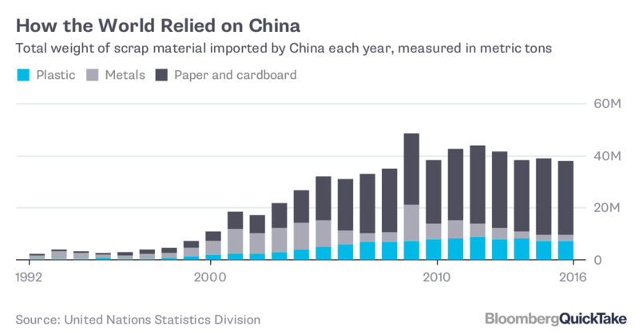

Slide 9
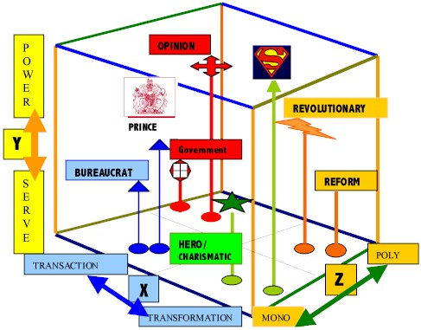
Now in 2018 recycling leadership is transactional (X), power over (Y), and mono-voiced mono-logical , with the PRINCE, BUREAUCRAT ➔ Leadership in Society
Notes:
Now in 2018 recycling leadership is transactional (X), power over (Y), and mono-voiced mono-logical , with the PRINCE, BUREAUCRAT ➔ Leadership in Society

Slide 10
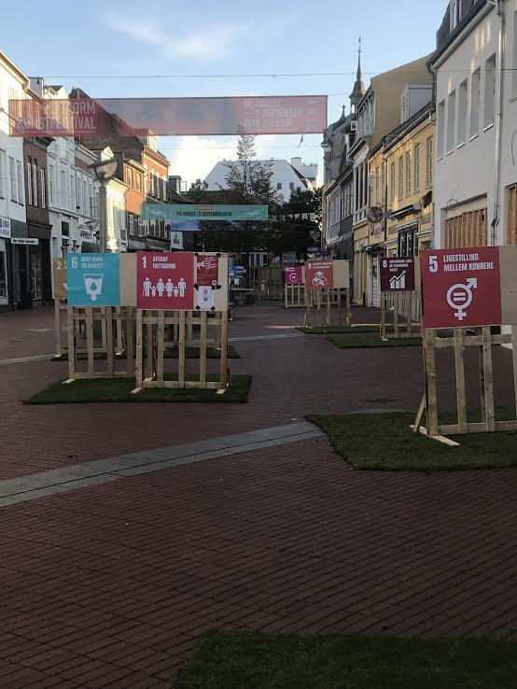
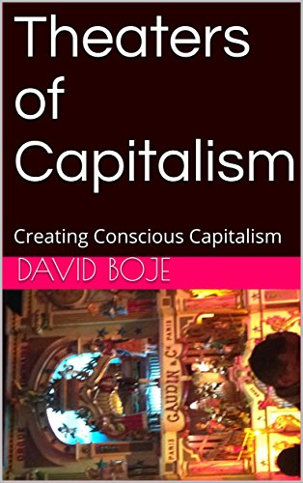
Kolding’s Popup of 17 UN Sustainable Development Goals August 25-26 2018

Slide 11
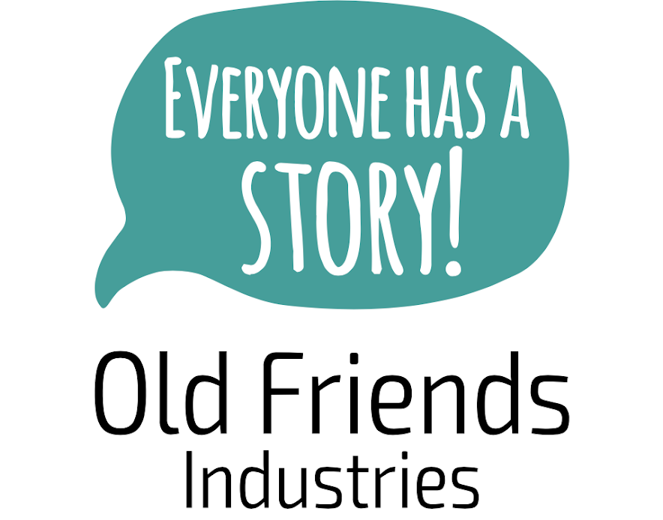
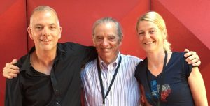
What is True Storytelling?
Jens Larsen, David Boje, & Lena Bruun
Http://truestorytelling.org

Slide 12
How to Implement True Storytelling?
What is TRUE STORYTELLING now?
How to plan FUTURE?
When & Where to do PROJECT?
Reflect on OUTCOMES?

Slide 13
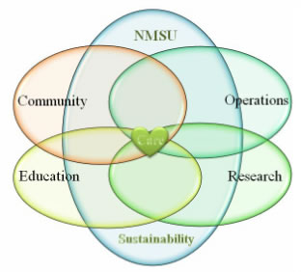
1st True Storytelling Principle: You yourself must be true and prepare the energy and effort for a sustainable future.
4 Questions:
Did you check it out?
Do you believe in it?
Do you have the knowledge to do it?
Can you sustain (get energized & not burn out) in long future?
Notes:
Example: Living Stories with a Place, A Time, and a Truth of lived experience
Happening Here and Now
In the middle, unfolding, emerging, happening
Goes from strategic level of power, to what is best for the world in Council of Elrond
Tell LESS is MORE
BE AUTHENTIC - Create an emotional component that resonates with the audience YouTube Peter Guber of Mandalay Group, so they retell it forward owning; See article 4 truths of the storyteller HBR

Slide 14
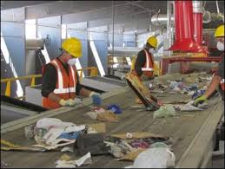
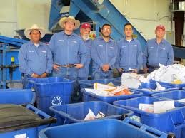
Is NMSU Declining in Recycling since 2007?
Let’s take a look at the six College’s recycling systems in all their buildings?

Slide 15
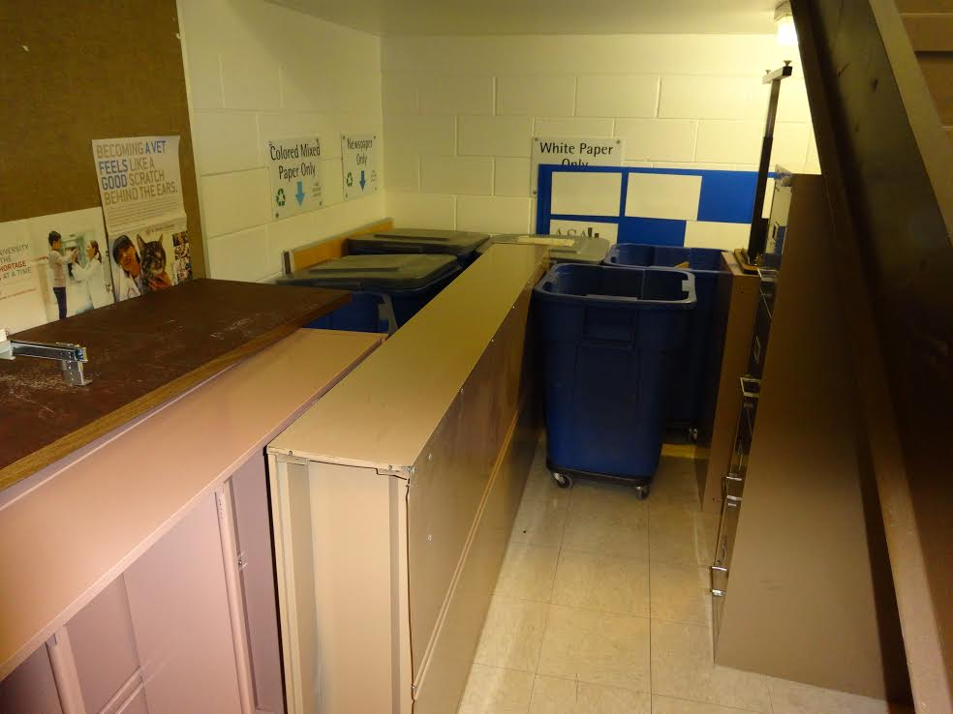
Recycling in Business Complex Building moved from lobby and third floor locations to beneath the first floor stairwell
THINGS TELL A STORY
Observe the Micro-Spaces of THINGS telling a story

Slide 16
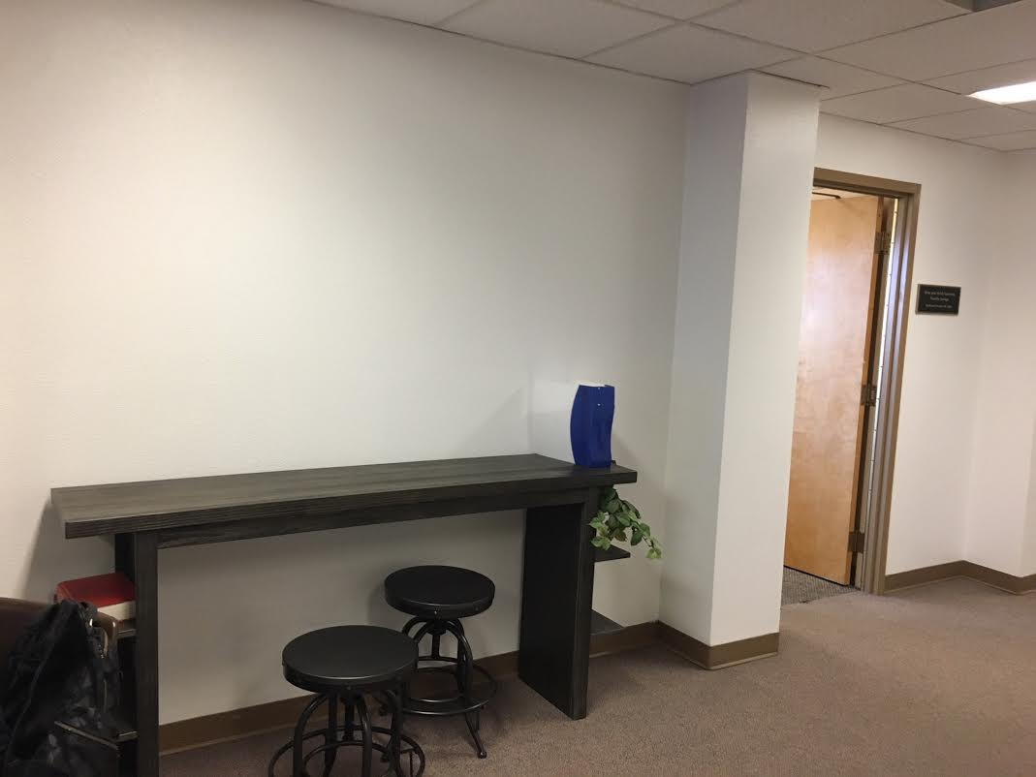
Two months ago there used to be 3rd Floor Business Complex recycling center, with signage
ABSENCE of RECYCLE BINS TELL A STORY

Slide 17
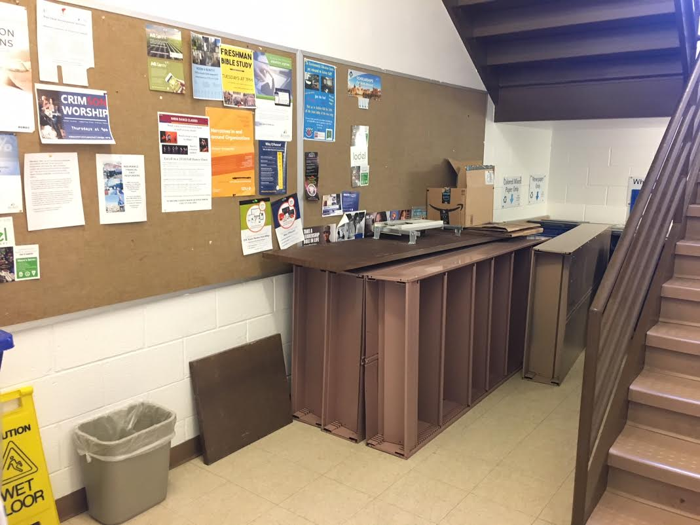
1st Floor Business Complex has recycling all under stairway
THINGS TELL A STORY

Slide 18
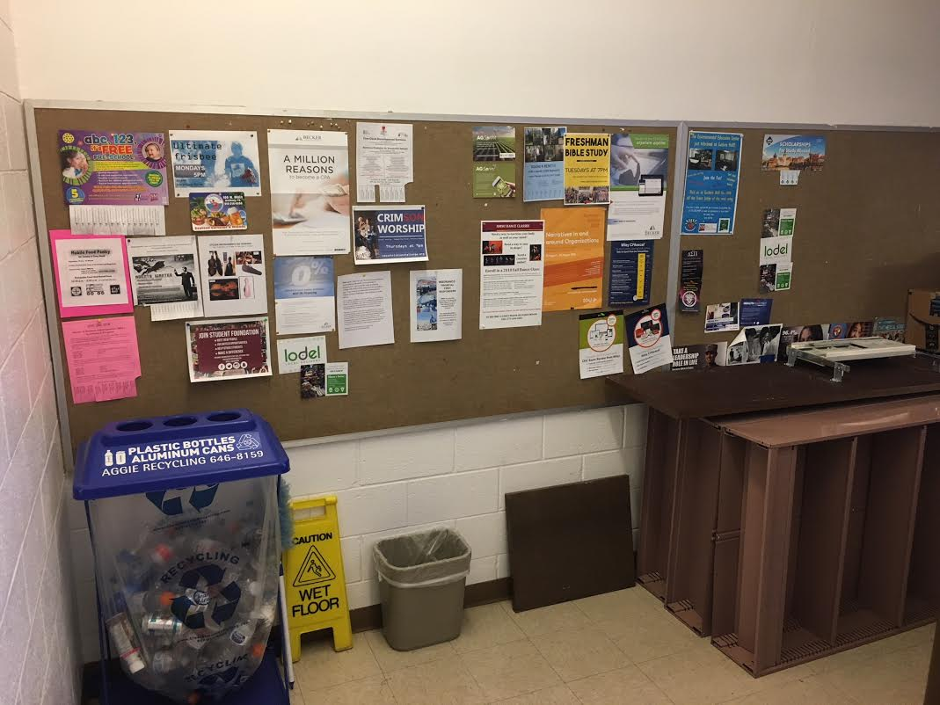
Location of Aluminum can/plastic recycling is in Business Complex 1st floor stairwell instead of near larger classrooms on all three floors
THINGS TELL A STORY

Slide 19
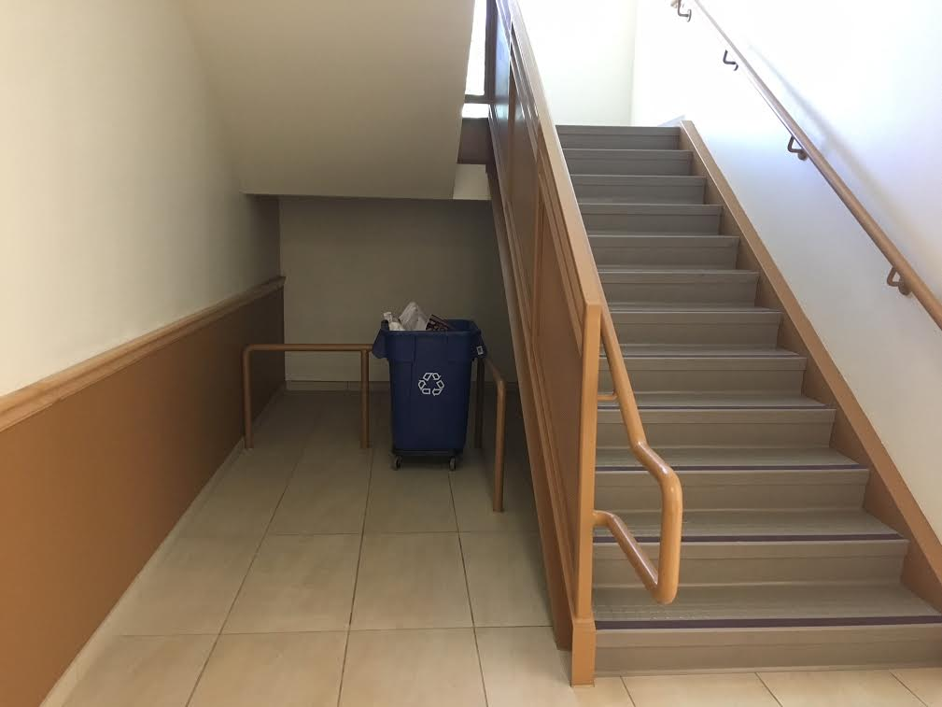
Domenici Building – recycling is in stairwell instead
THINGS TELL A STORY

Slide 20
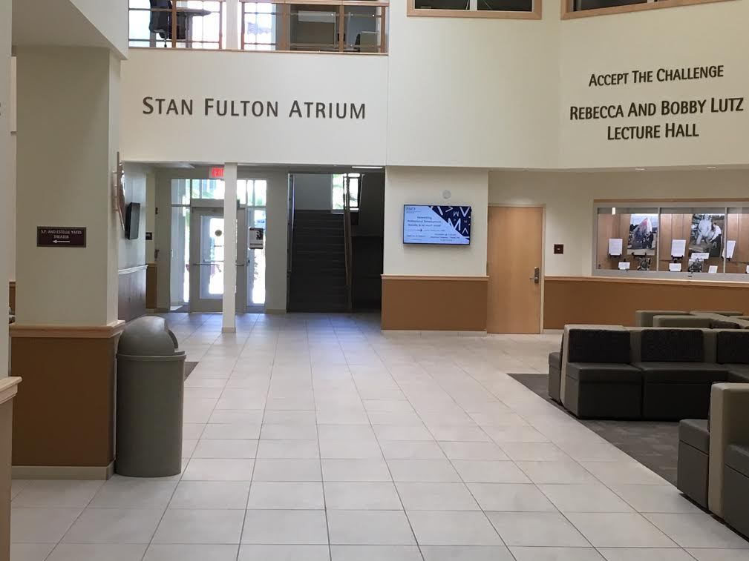
Can we find a way to have recycling in main areas (Domenici Building example)
Observe the Micro-Spaces of THINGS telling a story
ABSENCE of RECYCLE BINS TELL A STORY

Slide 21
Where are the recycling bins in Guthrie Building?
The plastic/aluminum bin is in 1st floor of administrative wing of building. Can you find a 2nd one?
Somewhere there is at least one large blue bin on wheels. Can you find it?
There are no recycling bins in the classrooms, so students just contaminate their recyclables by tossing them in the trash can.

Slide 22
Principle 2: True storytelling makes spaces respecting the stories already there
RESPECT what is there NOW
Our INTERACTIVE ACTIVITY: Take Campus TOUR to SEE the TRUE STORYTELLING now.
Invite people there now, & include Mother Earth storyteller?
What is Mother Earth (living story) of each college’s recycling system?
Notes:
Diane Dredge suggested Bus Tour with all the stakeholders on board on Tues May 8 2018 at Aalborg, at conference held there on storytelling
How to tell a motivating & inspiring story? MOST ENGAGING STORY WAITING TO BE TOLD IS YOURS! I was so shocked, surprised, stupid, suspicious (HOW DID YOU FEEL?)
What is ENGAGING & EMOTIVE-language? – when audience is ENERGIZED (look to body language) – START WITH CONTEXT (PAINT THE VIVID SCENE) e.g. in my driving through woods, icy roads, snowing, on mountain road ADD DIALOGUE
A PROBLEM, an OBSTACLE to OVERCOME: E.g. When I was first person in family ever to go to college? SET UP FOR THE TIMING POINT (THE ARC is SET) THEN SURPRISING TURNING POINT seeYouTube: Jim Carey
A proud moment when MORAL OF STORY →YOU inspired others? THE RESOLUTION E.g. When Bo Kimble died, the team used my motto to move forward

Slide 23
TRUE STORYTELLING OF NEW MEXICO RECYCLING HISTORY
In early 1980’s, New Mexicans relied on community “dumps” which were often nothing more than open trenches.
These “dumps” were regularly set on fire to “reduce” their volume and to make way for more trash.
These sites are scattered across the state and can be found in close proximity to every pueblo, village and rural community.
Managing solid waste in this way meant groundwater, surface water, or air could easily become polluted. SOURCE
Notes:
. http://www.recyclenewmexico.com/wp-content/uploads/2015/04/Recycling_Resource_Kit_2015.pdf

Slide 24
EXERCISE Principle 2: True storytelling makes spaces respecting the stories already there
Think of a story when you helped people respect how it is now, in the already there?
HOW COULD YOU TAKE A TOUR WITH THEM ALL, or HAVE YOUR STAKEHOLDERS EXPERIENCE THE SERVICE?
SHARE WITH ANOTHER PERSON & LISTEN TO THEIR EXAMPLE OF PRINCIPLE 2

Slide 25
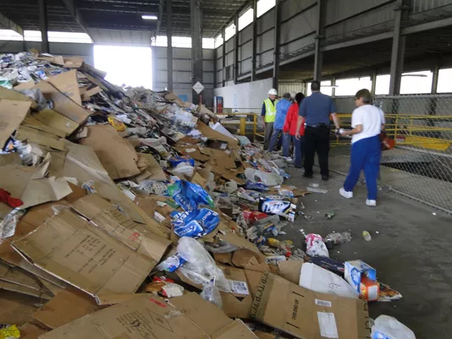
Sun News, 2018
“Things tell a Story” (William James, 1907: 96)
Our NMSU recycling of things tells a story of CONTAMINATION!
“Contamination” means residents putting materials in their blue bins that are NOT recyclable – food, trash, and various non-recyclable materials.)
Notes:
Time is running out as US land fill capacities fill up https://nrra.net/sweep/time-is-running-out-the-u-s-landfill-capacity-crisis/

Slide 26
Japan and US
With similar, GDP, Japan generates 1/3rd less waste, per capita, than the US
US throws out 4.5 pounds trash per person per day
US contaminates the recyclables, and China is no longer accepting them

Slide 27
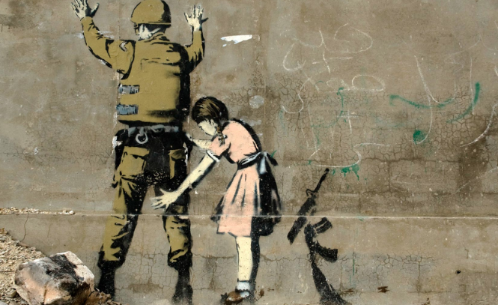
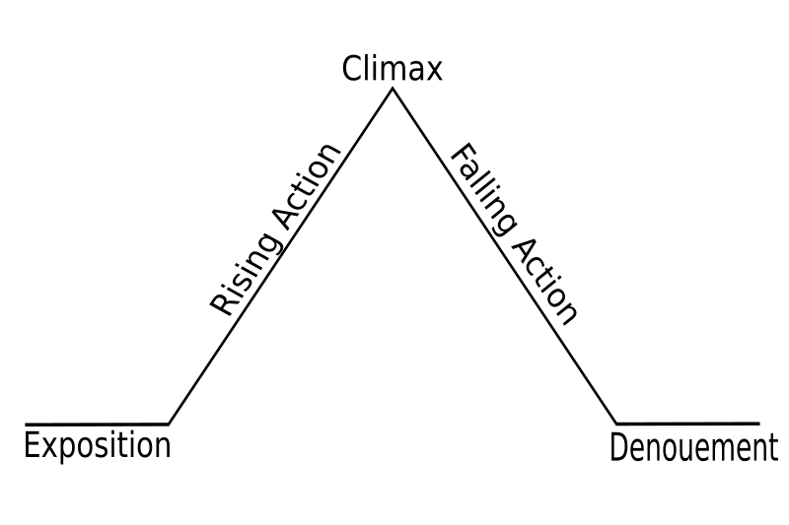
Principle 3: You must create stories with a clear plot creating direction and help people prioritize
We are ready to plan new future that is a PATTERN BREAKER from Past
We want a good plot that is TRUE STORYTELLING
It has Beginning, Middle & End to be Clear Direction
It tells WHY we are doing this
Best Plots have a TWIST, what Roland Barthes calls “PUNCTUM”
Banksy’ street-art YouTube
Notes:
In change people grasp for a narrative plot with clear why. A Punctum helps this.
Lars Bo H. presentation in Aalborg May 19 2018 spoke of the WHY in plot.

Slide 28
New Mexico in Global Crisis
New Mexico among 1st states to feel crisis effects in 2017 (NM Recycling Coalition).
Many NM municipalities stopped receiving rebates in fall 2017.
There are slower line speeds, extra labor (50 new staff in Albuquerque) to meeting China’s new rules.
Same for Las Cruces. Cities in NM beginning to see material pile up due to continuous low pricing.
Las Cruces paying additional $40,000 a month; Santa Fe paying $540,000
Las Cruces will inspect carts for contamination in September 2018, and issue ‘Oops’ tag. (Waste Dive)

Slide 29
The Global Scale of Recycling
Globally only 14% of plastic packaging is recycled & 8M tons ends up in ocean yearly (Washington Post, 2018)
Electronic Waste 50 million metric tons in 2018; 25% is personal E-waste (UN Report)
Until 2018 China took 50% of world’s plastic & paper recycling waste; but now bans 24 types of solid waste, including various plastics and unsorted mixed papers, and sets a much tougher standard for contamination levels (Environmental Paper Org)
Recycling creates about 1.25 million US jobs (Guardian, 2017)
Notes:
https://www.washingtonpost.com/outlook/five-myths/five-myths-about-recycling/2018/04/20/9971de66-43e6-11e8-8569-26fda6b404c7_story.html?noredirect=on&utm_term=.c0f4b35711f0
https://www.popularmechanics.com/science/environment/a3736/4290631/
https://www.wastedive.com/news/what-chinese-import-policies-mean-for-all-50-states/510751/
https://www.csbsju.edu/sju-sustainability/what-were-doing/recycling/recycling-myths-and-excuses
https://www.motherjones.com/environment/2015/07/recycling-myths-blue-bins/

Slide 31
Space for a Break

Slide 32
True Storytelling Principle 4 You must have timing.
KAIROS: place & time when conditions are right for the accomplishment of a crucial ’intelligent’ action
NOT the Beginning Middle End CHRONOS type of Narrative Plot we just did
Rather it is the fleeting RIGHTNESS of PLACE and TIME, and Material-Circumstance for an Opportune Moment
E.g. David’s Story of Meeting Grace Ann & an opportune moment of action

Slide 33
TIMING – China’s changes to Recycling standards
What is recyclable is changing with what Leaders and Authorities are judging chat is recyclable and what is waste for trash landfill.
Non-judicial elements since price of recyclables in recyclable markets (in China & locally) becomes ENTANGLED with the science (knowledge) of what is possible to recycle.

Slide 34
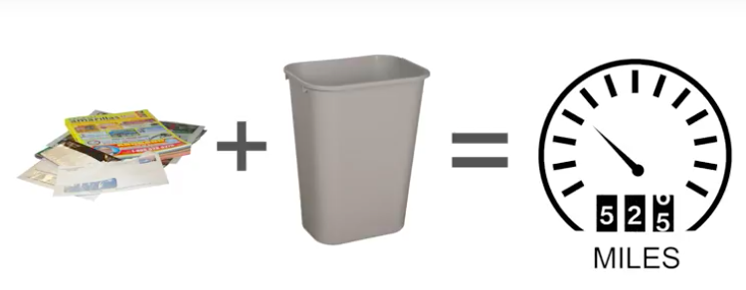
SCIENCE KNOWLEDGE: If you throw away even half the paper you use in a year instead of recycling it, you increase your climate pollution by the same amount as driving 526 miles
IDEAS ON HOW TO RESOND TO THE RECYCLING CRISIS IN the USA:
https://www.recycleacrossamerica.org/us-recycling-collapse

Slide 35
True Storytelling Principle 4 You must have timing.
KAIROS: place & time when conditions are right for the accomplishment of a crucial ’intelligent’ action
NOT the Beginning Middle End CHRONOS type of Narrative Plot we just did
Rather it is the fleeting RIGHTNESS of PLACE and TIME, and Material-Circumstance for an Opportune Moment
E.g. David’s Story of Meeting Grace Ann & an opportune moment of action

Slide 36
Practice Principle 5: You must be able to help stories on their way and be open to experiment
What is TRUE STORYTELLING now?
How to plan FUTURE?
When & Where to do PROJECT?
Reflect on OUTCOMES?

Slide 37
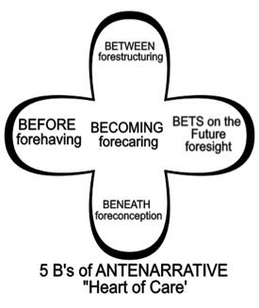
Practice Principle 5: You must be able to help stories on their way and be open to experiment
QUESTIONS:
How is NMSU preparing in advance BEFORE the future takes place?
What is in advance BENEATH in fore-conceptions?
Identify any BETWEEN the parties, in their fore-structuring?
What are the BETS on the future made with foresight?
What is the entire BECOMING, forecaring?
Notes:
Practice capturing attention, and getting it back when it moves away
Find pulse of audience, then hold it
Prepare the future in advance
Bring new future into being that changes everything before

Slide 38
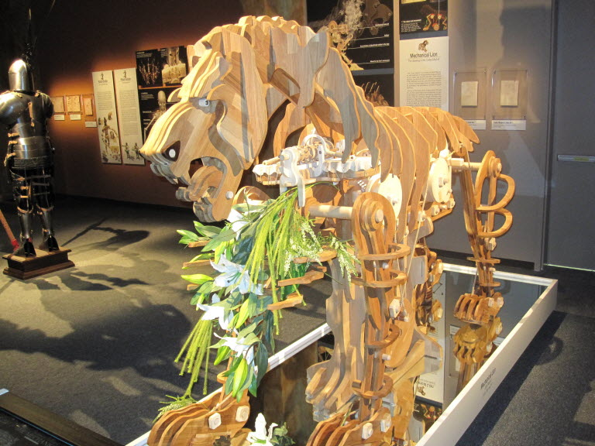
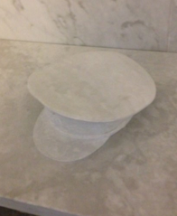
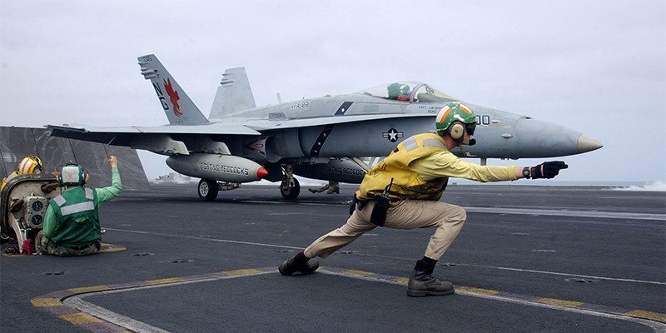
Principle 6: You must consider staging including scenography and artifacts.
How are material & social agents part of the staging & artifact of RESTORYING?

Slide 39
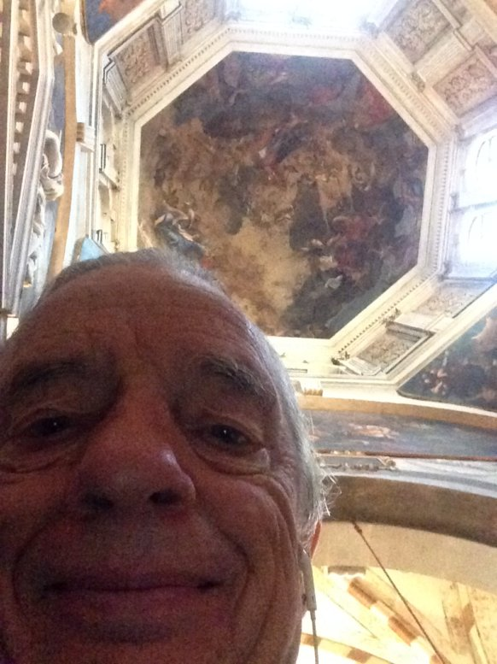
Our place in the world
“Wherever we are, each of us, with our awareness centered inner bodies, is the center of our world. Where we are at any given time is the place, our place in the world. The world of our present consciousness is here and now. Each of us is centered upon ourselves, and from this state of centered presence comes the idea that the surface of the earth is centered at a particular place” (Pennick, 2015: 37).

Slide 40
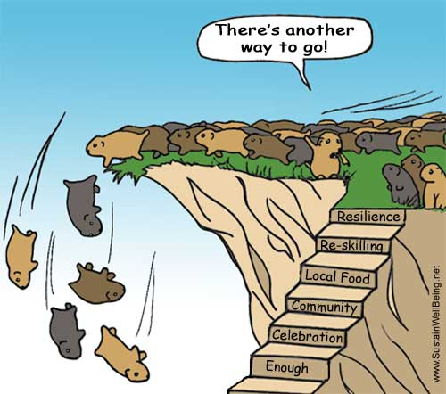
TRUE STORYTELLING Principle 7 You must reflect on the stories and how they create value.
Can you pull yourself up and look at the WHOLE SITUATION?
Lemmings are not REFLECTING on long-term value?
How a FAKE Corporate Social responsibility story loses value?
TRUE STORYTELLING: Whanganui River and Mount Taranaki declared legal persons

Slide 41
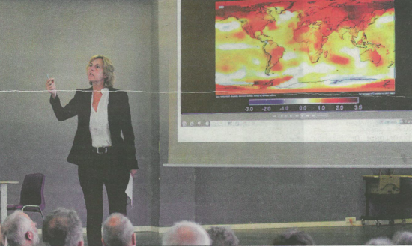
Sorø Municipality to implement UN GOALS
See Global Indicator Framework

Slide 42
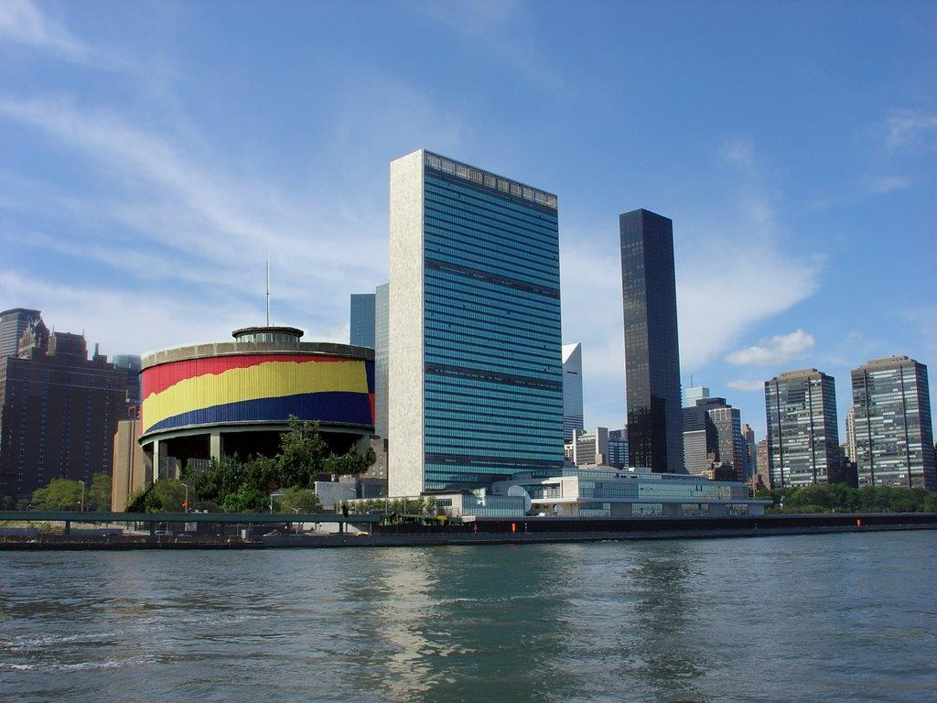
Til Søren to implement UN Goals needed a Punctum
Take Sorø
Municipality to the UN

Slide 43
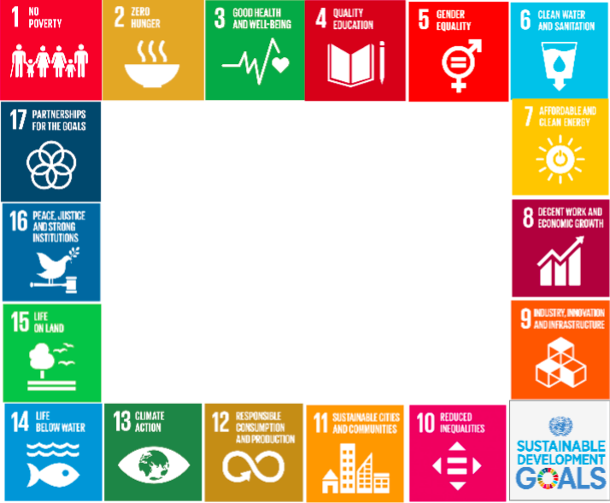
What is TRUE STORYTELLING now?
How to plan FUTURE?
When & Where to do PROJECT?
Reflect on OUTCOMES?

Slide 44
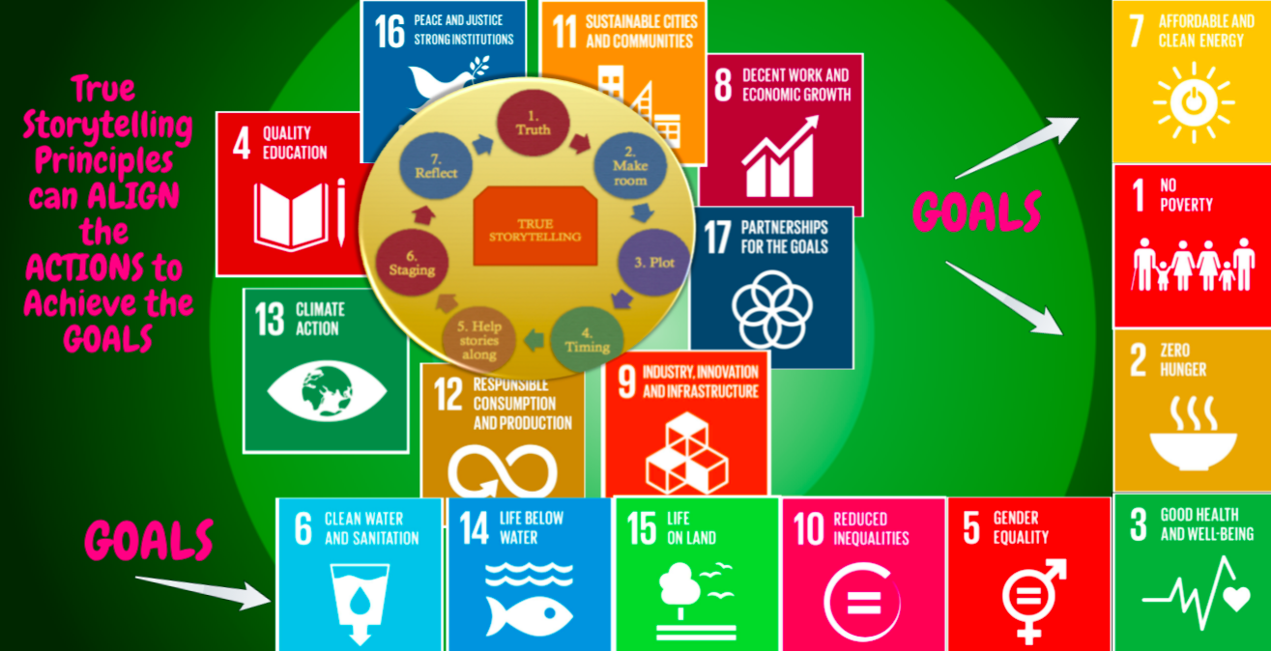

Slide 45
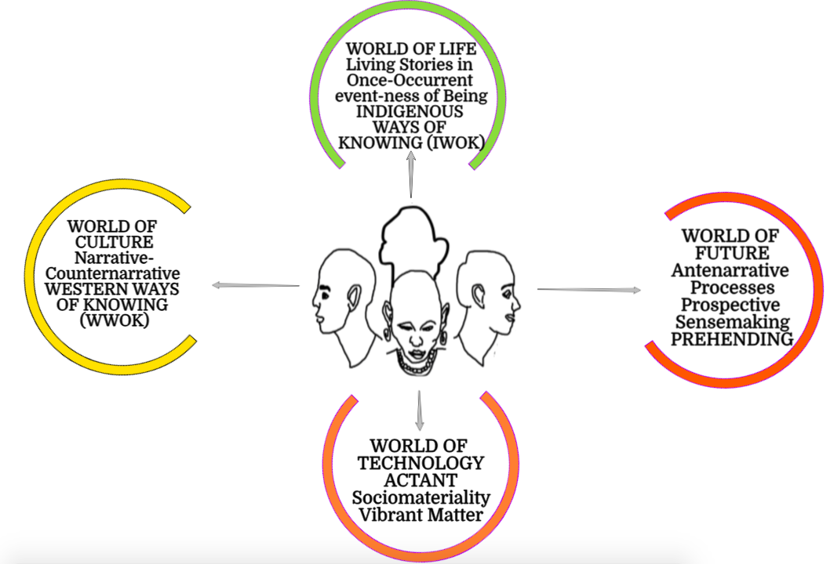
Fourfold Faces & Worlds of Storytelling

Slide 46
LIVING STORIES: A river and a mountain now have legal rights of a person in New Zealand
We are each MORALLY ANSWERABLE for our day by day TRACH in the event-ness of Being
We live in the WORLD OF LIFE

Slide 47
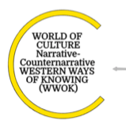
WWOK treats earth as a resource to be plundered
The counternarrative is Earth resources are being depleted

Slide 48
ACTANTS are things Things are material intra-acting with Social habits & routines
Consumption and production are human routines, consuming and producing THINGS
Technology is equipment & tools to make consumable things

Slide 49
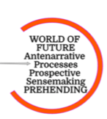
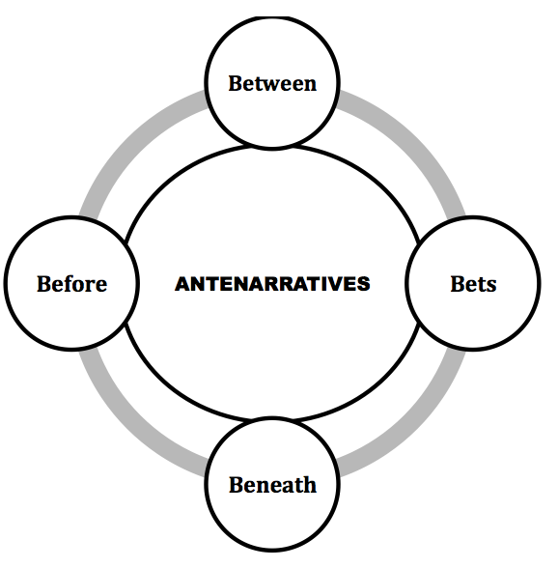
Antenarrative means Preparing in Advance for the Future Choosing Which Future to Actualize
PREHENSION – grasping some THING, taking control of things, to manage the Future

Slide 50
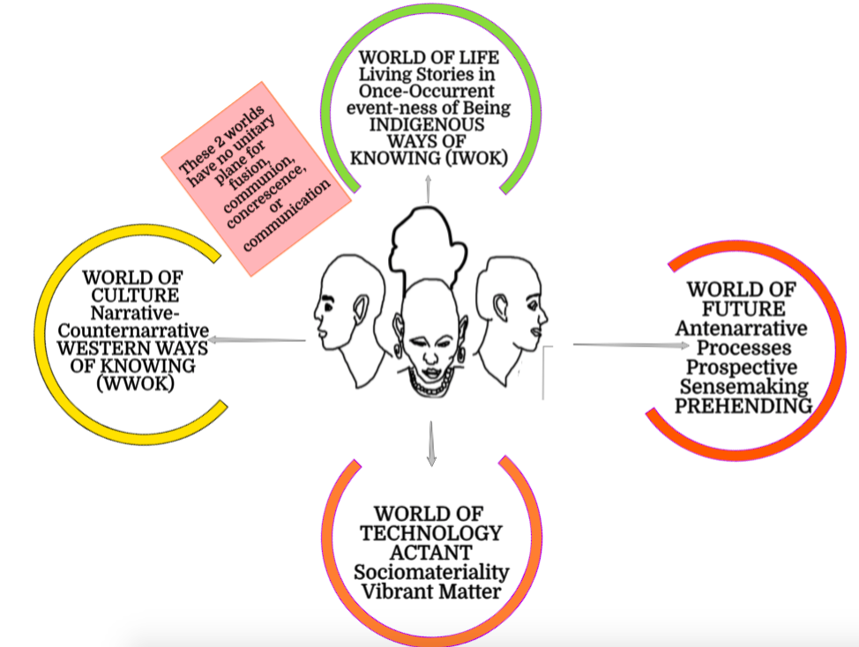
THE GAP BETWEEN 2 of the WORLDS

Slide 51
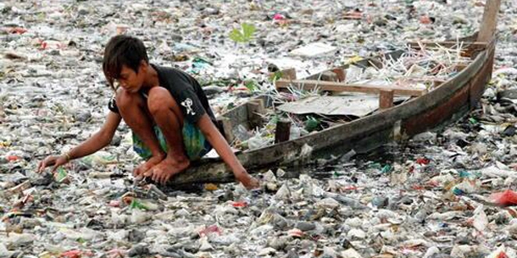
A block between WORLD OF CULTURE & WORLD OF LIFE
Plastic Things Tell A Story
The World of Culture produces Waste which Kills World of Life faster than we can RECYCLE, REDUSE, REUSE

Slide 52
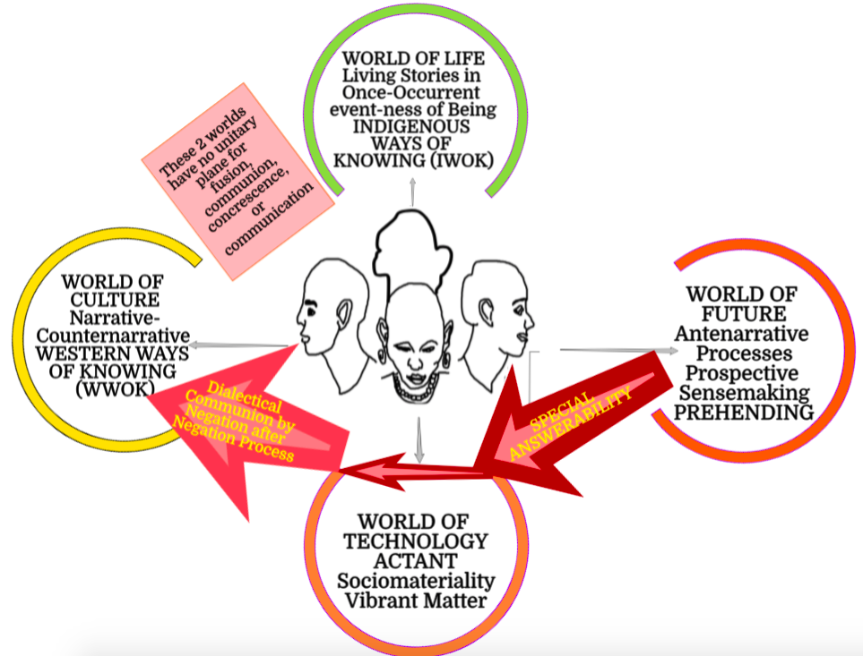
FIRST ANTENARRATIVE PROCESS IS DIALECTICAL

Slide 53
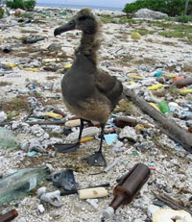
World of Culture ➔World of Technology is polluting World of Life
Besides killing wildlife, plastic and other debris damage boat and submarine equipment, litter beaches, discourage swimming and harm commercial and local fisheries. The problem of plastic and other accumulated trash affects beaches and oceans all over the world, including at both poles. Land masses that end up in the path of the rotating gyres receive particularly large amounts of trash.

Slide 54
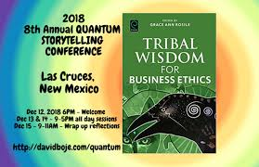
Antenarrative PATH 2
Learn INDIGENOUS Ways of Knowing & Being that are in Balance with World of Life

Slide 55
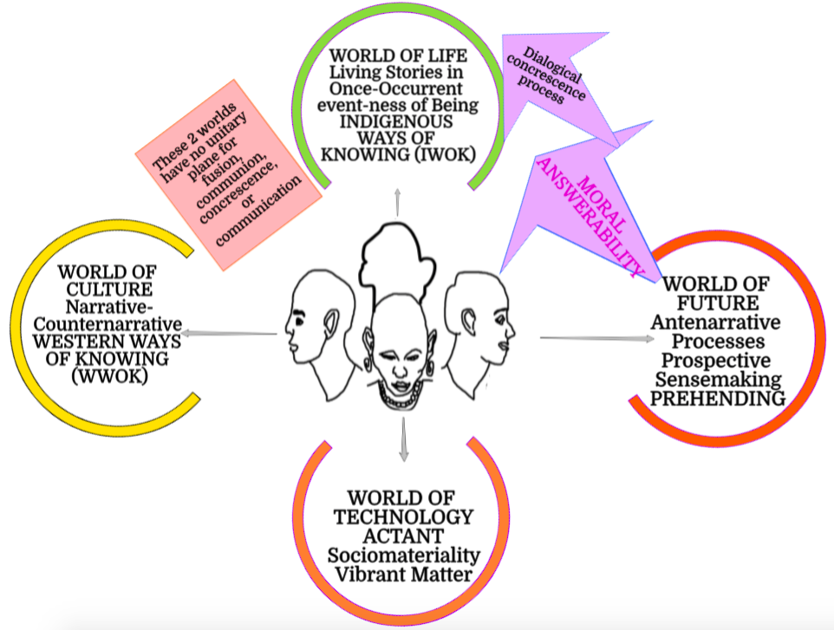
2nd ANTENARRATIVE PROCESS IS DIALOGICAL

Slide 56
Walter Benjamin 1936
Said “Storytelling is Coming to an End”
Because the skill to tell a living story and to listen and understand living story is less than it was
Why? Because workers no longer allowed to sign and tell stories at work
Because of the rise of Western Narrative that is disconnected from CONTEXT, UNGROUNDED to Mother Earth

Slide 57
IWOK Storytelling is Coming to an End
IWOK Storytelling of relation of World of Live to Ethical Answerability giving way to World of Culture Narratives
Many World of Culture Narratives promise CORPORATE SOCIAL RESPONSIBILITY that is FAKE NARRATIVE, ILLUSION, or GREENWASHING

Slide 58
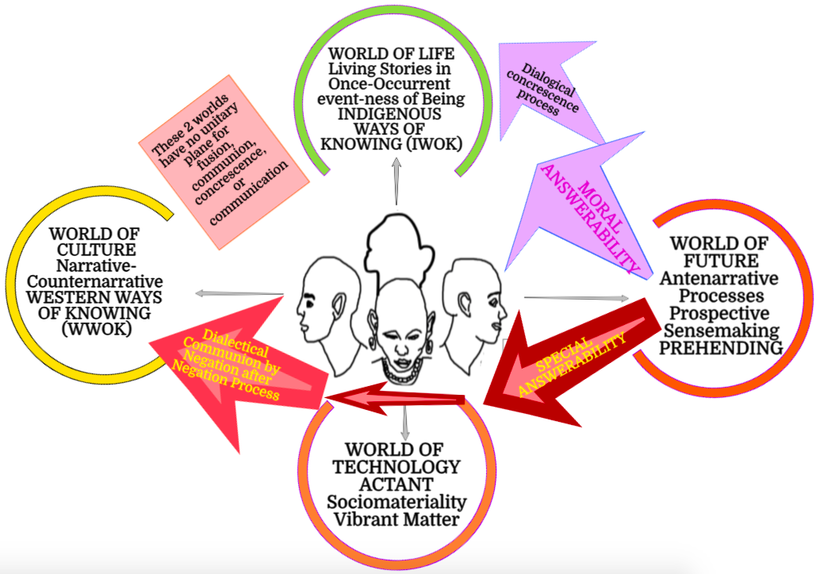
4-Fold Storytelling Paradigm

Slide 59
Things tell a story
Not just people tell stories
Things tell a story
Assemblages of things tell a story
Pictures tell a story
Stuff you carry with you tells a story
Things in your office tell a story
Things are ACTANTS mediating Human Routines in a business

Slide 60
Antenarratives are processes
Antenarratives are choices among FUTURES
NMSU prepares in advance for this or that Future
Antenarrative constitutes BEFORE narrative or story
Antenarrative is before, beneath, becoming, between, and bets on the future coming

Slide 61
Summary: How to Enlighten Recycling at Universities
Things Tell a Story
Get Forensic about Recycling
Question Greenwashing
Where are the actual recycling systems, the bins, the places to recycle
What is happening to material things you recycle?

Slide 62
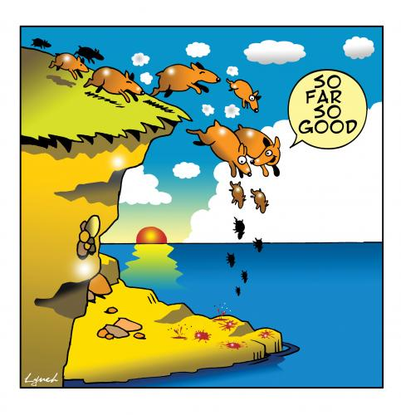
THANK YOU
Questions & Answers
Jens Larsen, Lena Bruun, & David Boje
TRUE STORYTELLING
+45 28 92 20 97
info@oldfriendsindustries.com
Værnedamsvej 12 A.
1619 København V
http://truestorytelling.org

